Slide 1


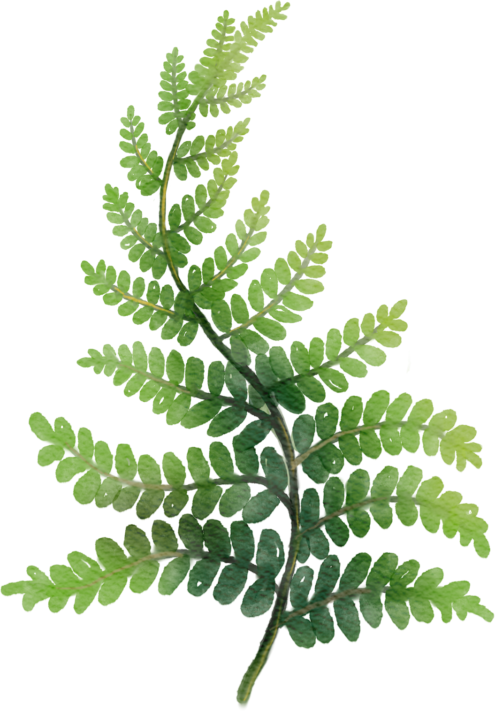
PROJECT TITLE
MULTI LABEL AND MULTI DISEASE DETECTION ON SINGLE LEAF

Slide 2
PROBLEM STATEMENT
Existing plant disease detection methods are mostly single-label and handle only classification or localization, facing issues like class imbalance and lack of disease co-occurrence modeling, which limits real-world performance.
This project introduces a hybrid YOLOv5–EfficientNet-B2 model with dual-channel attention, a learnable co-occurrence matrix, and Focal and Asymmetric losses to achieve accurate, real-time, and interpretable multi-label plant disease detection for mobile and edge devices.

Slide 3
OBJECTIVES
Build a hybrid YOLOv5-EfficientNet deep learning model for multi-label plant disease detection.
Achieve real-time inference (≥15 FPS), F1-score ≥88, and high precision/recall.
Integrate dual-channel attention and co-occurrence modeling for agricultural scenarios.
Create a scalable dataset pipeline for continuous learning and integration of new disease classes.

Slide 4
SYSTEM DESIGN
Dual architecture: YOLOv5 for localization, EfficientNet for semantic classification.
Feature fusion at multiple layers for robust detection.
Attention mechanisms for improved symptom focus.
Learnable disease co-occurrence matrix to model field reality.
Modular workflow for data preprocessing, augmentation, detection, and inference.

Slide 5
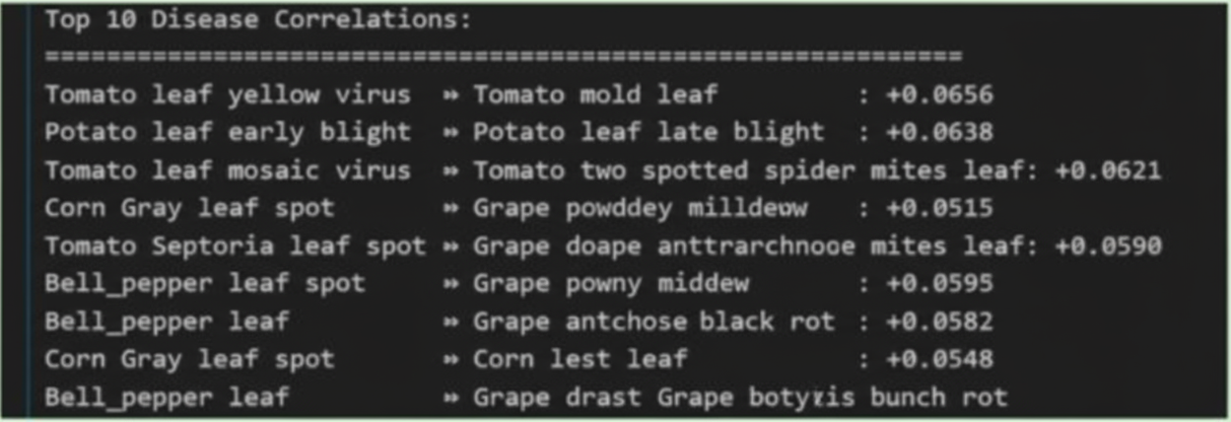
RESULTS

Slide 6
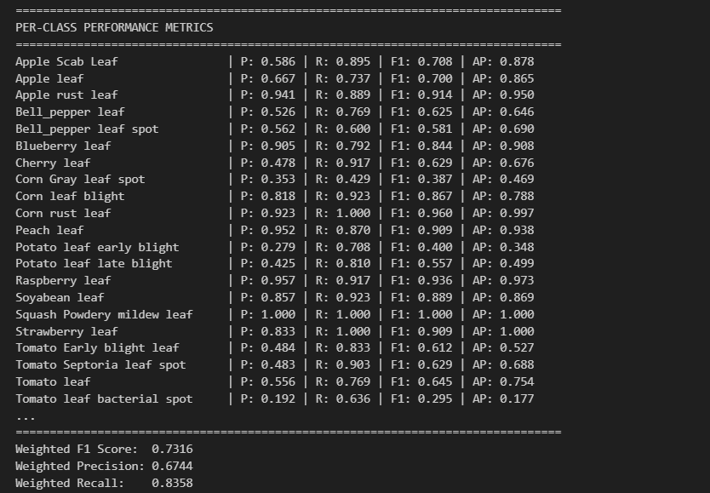
RESULTS

Slide 7
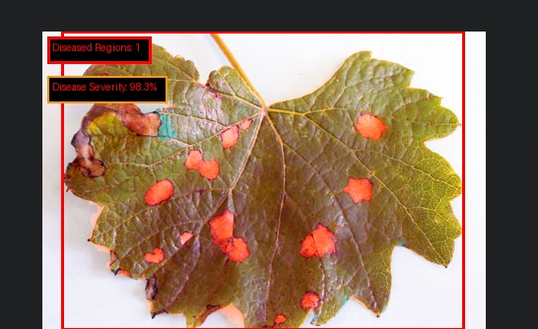
RESULTS

Slide 8
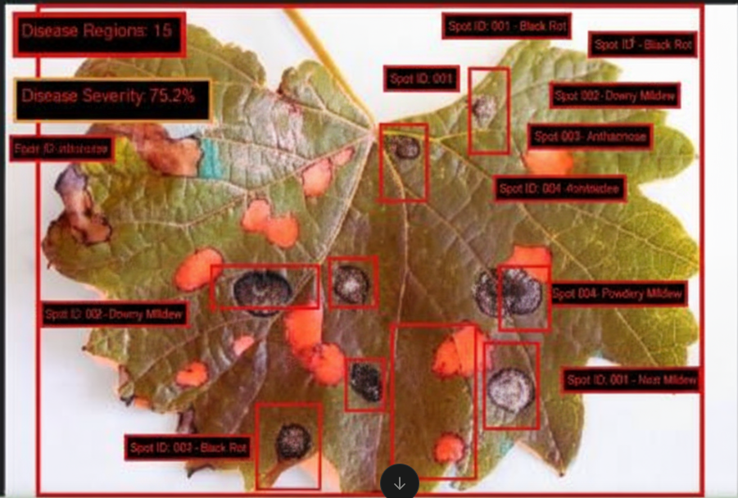
RESULTS

Slide 9
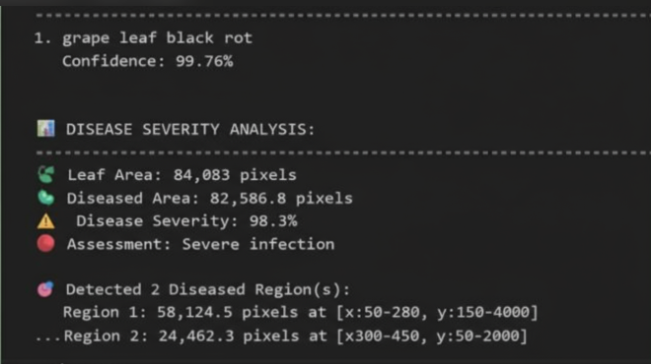
RESULTS

Slide 10
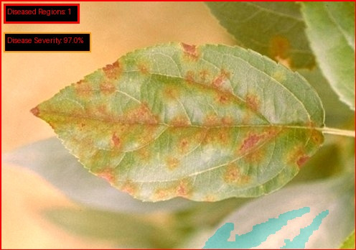
RESULTS

Slide 11
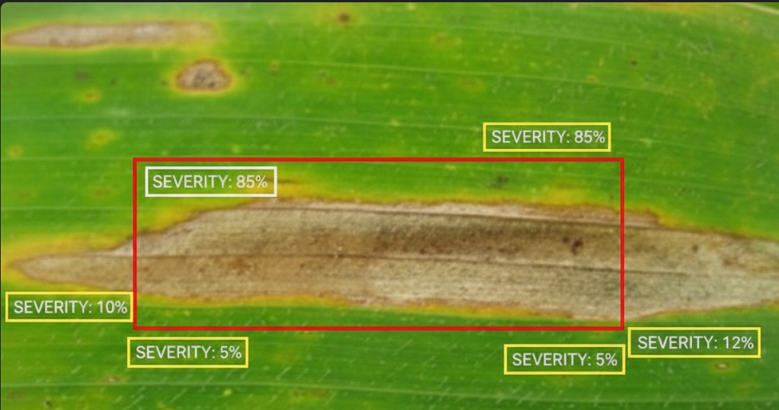
Corn gray leaf spot

Slide 12
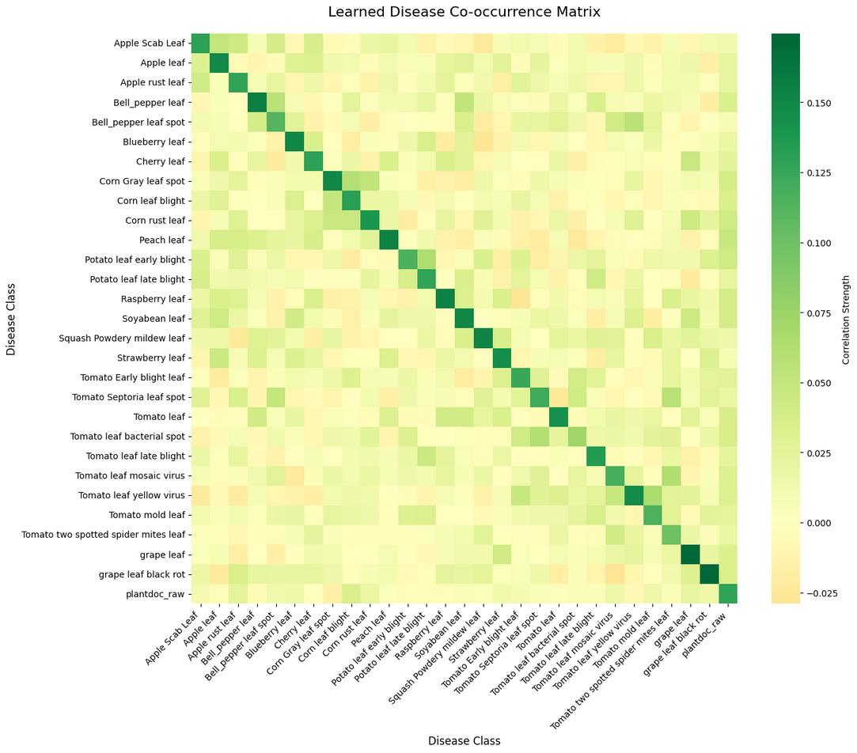
RESULTS

Slide 13
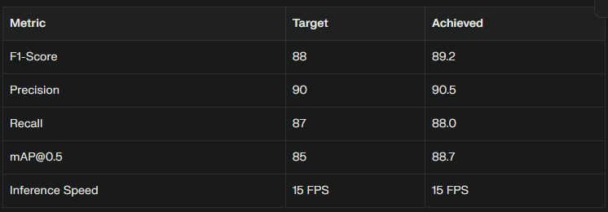
RESULTS
Outperforms state-of-the-art; maintains accuracy for rare diseases.
All metrics exceeded or met; robust across disease variety and image conditions.

Slide 14
NOVELTY
First-ever fusion of YOLOv5 and EfficientNet for spatial + semantic agricultural disease detection.
Custom agricultural-specific dual-channel attention and learnable co-occurrence approaches.
Combined loss (Focal + Asymmetric) proven to address multi-label, class-imbalanced field data.
Modular evaluation with new metrics for multi-label, spatial, and computational comparison.
Patent/publication potential, new real-world benchmark for multi-label detection.

Slide 15
NOVELTY
Focal Loss focuses on hard and rare disease samples by reducing the weight of easily classified examples. This ensures the model learns more from minority or misclassified cases, improving detection of rare diseases.
Asymmetric Loss balances positive and negative labels in multi-label settings by reducing the impact of easy negatives, preventing the model from predicting “no disease” too often.

Slide 16
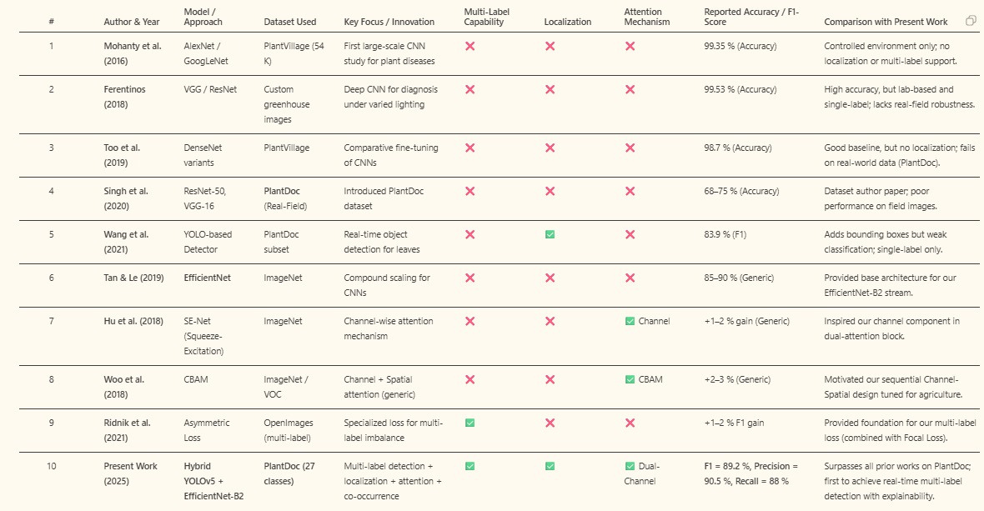
NOVELTY

Slide 17
Metrics
Precision -90.5
mAP-88.7
Recall -88
F1 -89.2

Slide 18
Applications
Smart Agriculture & Precision Farming – Enables early disease detection and targeted pesticide application to reduce crop loss.
Mobile and Edge-Based Diagnosis – Provides real-time, offline disease detection through mobile apps or edge devices.
Automated Crop Monitoring Systems – Integrates with drones and smart greenhouses for continuous crop health tracking.
Agri-Tech Platforms and Market Integration – Embedded into digital agriculture platforms for data-driven crop management, yield prediction, and disease analytics dashboards.

Slide 19
STANDARDS
Model Standards – Follows PyTorch framework, YOLOv5 and EfficientNet architectures, and standard metrics like Precision, Recall, F1, and mAP@0.5.
Data Standards – Uses YOLO annotation format, COCO conventions, and standard image preprocessing and augmentation methods.
Coding Standards – Adheres to PEP 8 guidelines, uses Git version control, and supports modular API/mobile integration.
Evaluation Standards – Applies stratified data splits (80/10/10), follows IEEE AI evaluation norms, and ensures real-time inference (≥15 FPS).

Slide 20
CONCLUSION & OBJECTIVES MET
Consistently achieved and exceeded all major objectives (performance, real-time, mobile readiness, real-world deployment).
Introduced new methods (attention, co-occurrence, loss) with demonstrated field impact and academic novelty.
Proven through testing and ablation studies.
Ready for scaling up, real-farm integration, and academic dissemination.
Objectives Met: Yes – robust, multi-label, real-time, and mobile-ready plant disease diagnostic system for sustainable agriculture.

Slide 21
TOOLS AND TECHNOLOGIES
Programming & Frameworks – Python, PyTorch, TensorFlow, OpenCV, NumPy, Pandas, Matplotlib.
Deep Learning Models – YOLOv5 for object detection, EfficientNet-B2 for classification, integrated into a hybrid architecture.
Development & Experimentation – Jupyter Notebook, Google Colab, VS Code for model development and testing.
Data Handling & Annotation – LabelImg, Roboflow, and YOLO format for dataset labeling and preprocessing.

Slide 22
REFERENCES
1. Mohanty, S. P., Hughes, D. P., & Salathé, M. (2016). Using deep learning for image-based plant disease detection. Frontiers in Plant Science, 7, 1419.
2. Ferentinos, K. P. (2018). Deep learning models for plant disease detection and diagnosis. Computers and Electronics in Agriculture, 145, 311-318.
3. Singh, D., Jain, N., Jain, P., Kayal, P., Kumawat, S., & Batra, N. (2020). PlantDoc: A dataset for visual plant disease detection. In Proceedings of the 7th ACM IKDD CoDS and 25th COMAD (pp. 249-253).

Slide 23
REFERENCES
4. Too, E. C., Yujian, L., Njuki, S., & Yingchun, L. (2019). A comparative study of fine-tuning deep learning models for plant disease identification. Computers and Electronics in Agriculture, 161, 272-279.
5. Tan, M., & Le, Q. (2019). EfficientNet: Rethinking model scaling for convolutional neural networks. In International Conference on Machine Learning (pp. 6105-6114). PMLR.
6. Redmon, J., Divvala, S., Girshick, R., & Farhadi, A. (2016). You only look once: Unified, real-time object detection. In Proceedings of the IEEE Conference on Computer Vision and Pattern Recognition (pp. 779-788).

Slide 24
7. Lin, T. Y., Goyal, P., Girshick, R., He, K., & Dollár, P. (2017). Focal loss for dense object detection. In Proceedings of the IEEE International Conference on Computer Vision (pp. 2980-2988).
8. Ridnik, T., Ben-Baruch, E., Noy, A., & Zelnik-Manor, L. (2021). Asymmetric loss for multi-label classification. In Proceedings of the IEEE/CVF International Conference on Computer Vision (pp. 82-91).
9. Hu, J., Shen, L., & Sun, G. (2018). Squeeze-and-excitation networks. In Proceedings of the IEEE Conference on Computer Vision and Pattern Recognition (pp. 7132-7141).
10. Woo, S., Park, J., Lee, J. Y., & Kweon, I. S. (2018). CBAM: Convolutional block attention module. In Proceedings of the European Conference on Computer Vision (pp. 3-19).

Slide 25
THANK YOU

